Slide 1
Lab 4
File System Management
NEU – 2018

Slide 2
Lab #4 – 6/5
Goal: Construct a program to manage a filesystem (directory hierarchy with nested directories and files)
Your program should be able to manage directories from a root directory, and directories can contain directories and/or files
There should be no upper or lower limits on the number of nested directories/files
NO DATA WILL NEED TO BE ACTUALLY BE TRANSFERRED OR ALLOCATED (only simulated) In other words, you don’t need to keep track of files or locations, simply that we “have” a file or directory, etc.

Slide 3
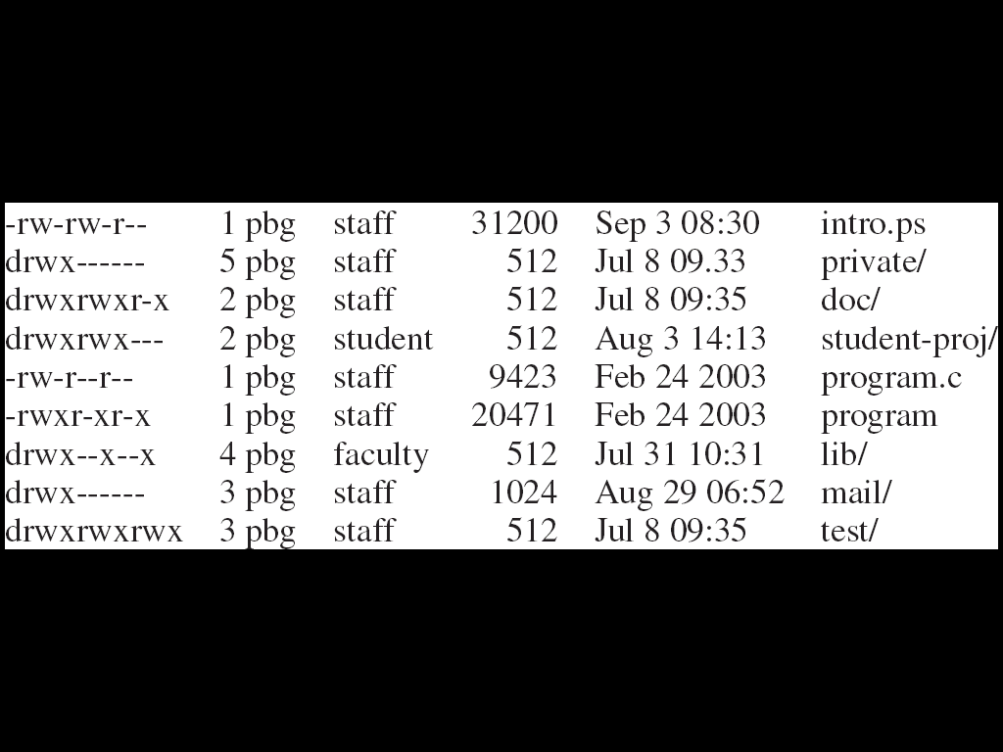
Interaction – like Linux
Allow the user to interact and modify the files/directories that your system manages
ls (lower case LS) print the current directory contents (names only)
ls –l (adds lower case L for long listing) print the data in long format (like below)

Slide 4
Interaction – like Linux
Needs to track permissions (can make up an owning user/size) needs to track last date modified (set to current system time)
Allow the user to see where they are in the directory structure with pwd (print working directory)
Allow the user to change directory with cd (can only change to a directory, not a file)
Change up a directory with cd .. or cd ../

Slide 5
Modification
mkdir to make a new directory
rmdir to remove a directory
touch to “create” a new file
rm to remove an individual file
chmod to modify permissions
Requires three digits – one each for owner, group, and public/world (usage on next slide)

Slide 6
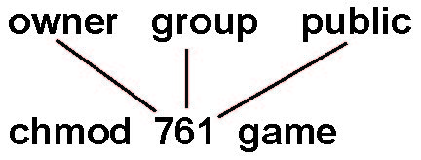
Access Lists and Groups
Mode of access: read, write, execute
Three classes of users on Linux
RWX
a) owner access 7 ⇒ 1 1 1 RWX
b) group access 6 ⇒ 1 1 0
RWX
c) public access 1 ⇒ 0 0 1
For a particular file (say game) or subdirectory, define an appropriate access.

Slide 7
Lab Considerations
Before: Consider
What data structures would work to handle scaling of directories and files?
What STL containers might work (don’t write your own from scratch!)
There will be a root to your file system (can call it / like linux …)
Will you need to handle permissions if I try to remove/modify something I don’t have access to?
How will you parse commands
How about formatting output (like ls –l)
How do you handle invalid input/requests?

Slide 8
Lab Considerations
During: Program, test, simulate, debug
Deliverable: Source Code in Blackboard (wechat/email backup): gosnmic @yahoo.com

Slide 9
Command Summary
pwd
cd <.. | sub-directory>
ls
ls –l
mkdir <dir name>
rmdir <dir name>
touch <file name>
rm <file name>
chmod <permissions> <file name | dir name>
exit | quit

Slide 10
Sample testing
mkdir home
cd home
mkdir mike
chmod 700 mike
cd mike
touch mike
ls –l
pwd
should be in /home/mike with a file called mike
https://www.tutorialspoint.com/unix_terminal_online.php
Type cat README.txt to get some help (or simply try our commands)

